Slide 1
RECIPE SEARCH ENGINE
WHEN YOUR FRIDGE IS RUNNING EMPTY

Slide 2
DEMO
Scraping with Selenium
Graphical User Interface (GUI)

Slide 3
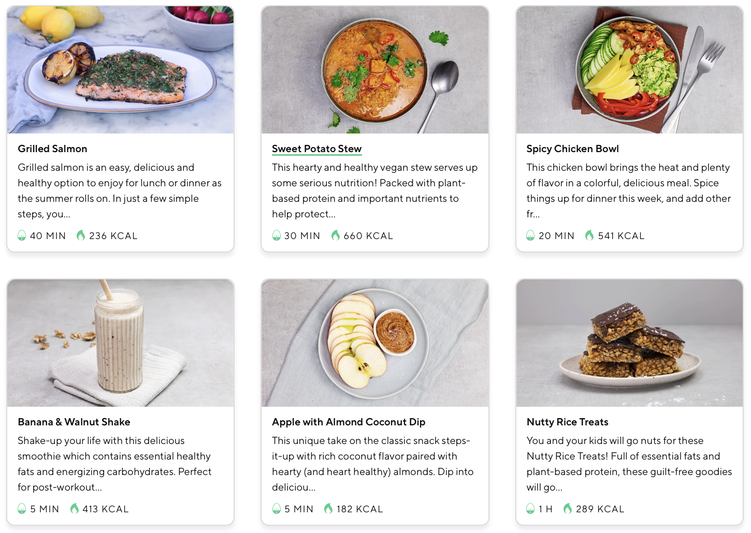
Lifesum recipes catalogue

Slide 4
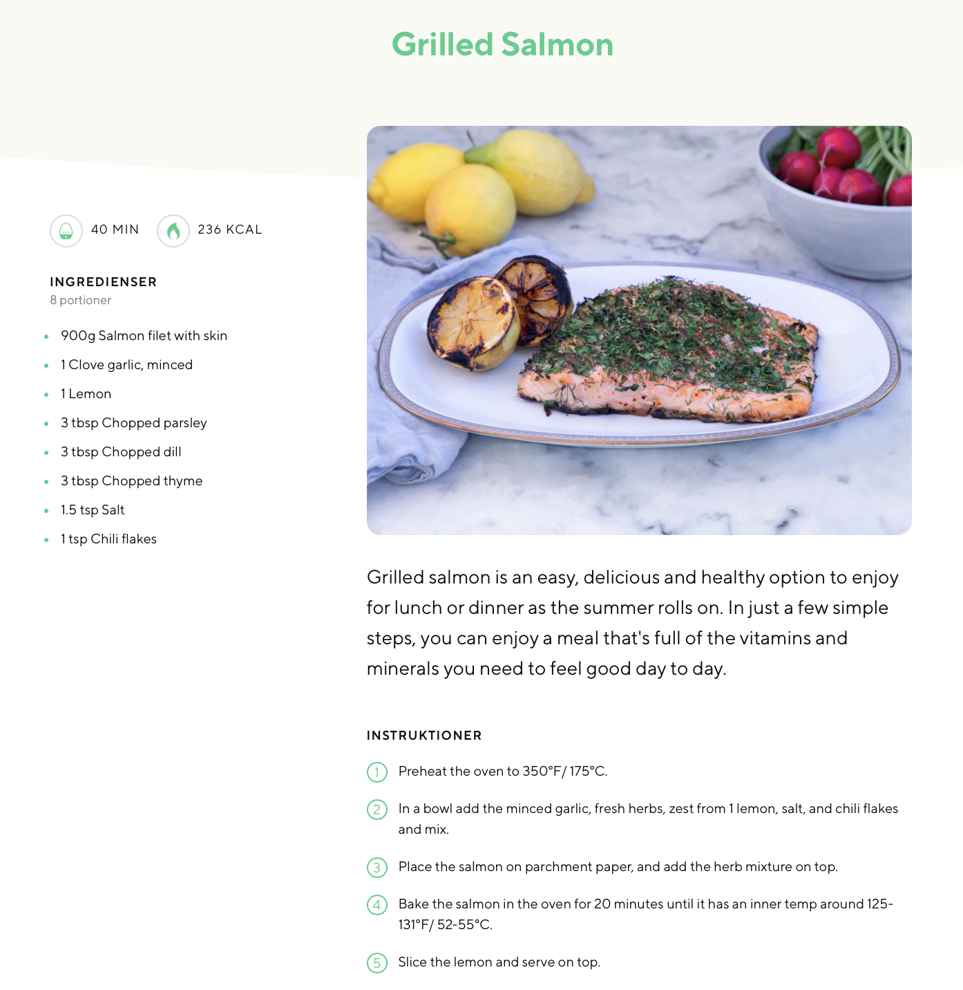
The recipe

Slide 5
Main functionality
Interactive recipe search using categories:
Ingredient in recipe
Time to cook
Amount of calories
Future improvements:
Additional recipes
Categorization of recipes = [“Breakfast”, “lunch”, “dessert”]
Improved interface

Slide 6
Challenges & Highlights
HTML code hiding content
Data storage options
Finding new python libraries
Delimitation of project / MVP

Slide 7

Questions? Croissants?

